Slide 1
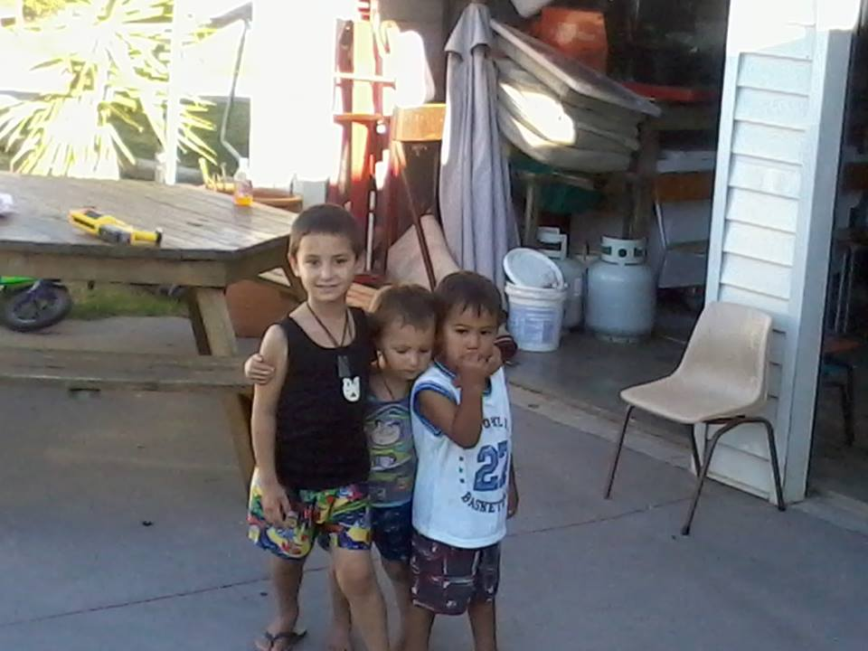
A Quarterly Overview
Ngatiwai Education Report

Slide 2
Te Au Here o Tukaiaia – Ngatiwai Education
STAFF June 2016
Kaumatua - Nupere Ngawaka
General Manager - Angeline Waetford
Trust Board Ed Leader - Kris MacDonald
Interim Unit Manager - Gayle Dowsett
Contract Manager - Petina Stone
Experts for specific contracts - Moana-Aroha Henry
- Dr Lily George
Education Team
Liz Flower, Rodney Ngawaka, Hohi Riini, Debbie Graham,
Lisa Riini, Honey Paora, Cassie Munson, Leila Amos, Iri,

Slide 3
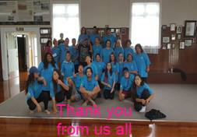
Contracts 2016
IMER 2016 – 2018
Early Childhood, National Standards & NCEA Level 2
Kokiritia te Ora - HRC 2016 – 2018
Research contract, Fighting passionately for life and wellbeing.
Nga Tau Miharo, - 2016- 2017
Positive parenting programmes
Kamo High School Putaiao, 2016
Science through te Ao Maori
Te Matarau 2016
Pastoral care for Northtec students in Kaitaia
Pending Contracts
SELO – Early learning
TPK - Support for Whangaruru Youth through Wananga

Slide 4
Thursdays at Toll Stadium
A highlight of our week
Kaumatua me Kuia o Ngatiwai kei te ra
Organized by Liz Flower and run by Kaumatua and Kuia sharing matauranga Ngatiwai with each other. Ngatiwai reo, waiata and education activities are planned and all are welcome to attend. We all join together for a shared lunch.
Liz reminds regulars each week and keeps in touch on facebook.
Plans for expanding is underway with more whakawhanaunga planned
A fantastic day was held last week where Kuia were treated to hair do’s and then all were treated to lunch with Erica to give her a whakawatea.

Slide 5
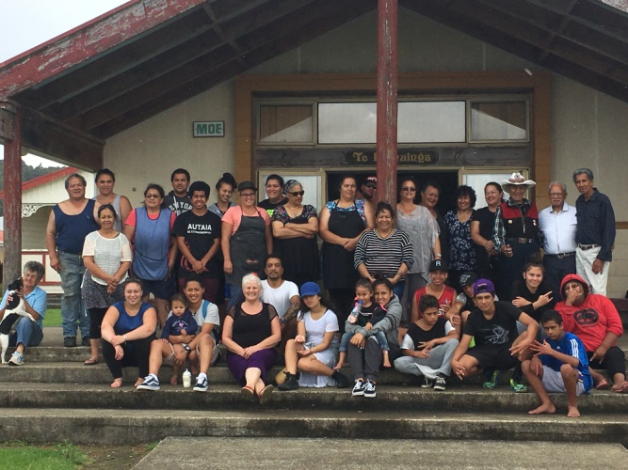
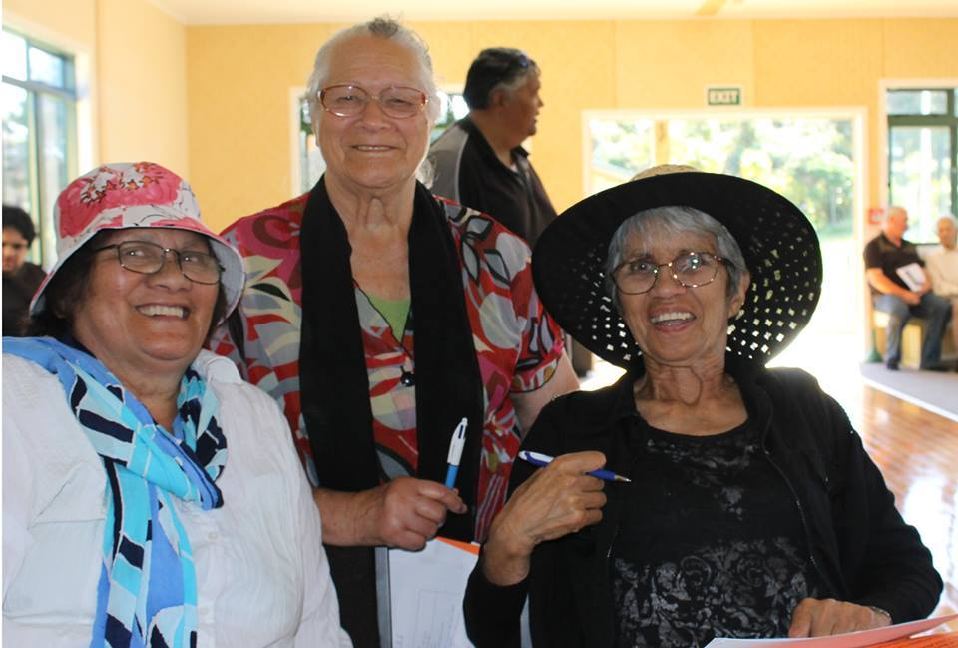
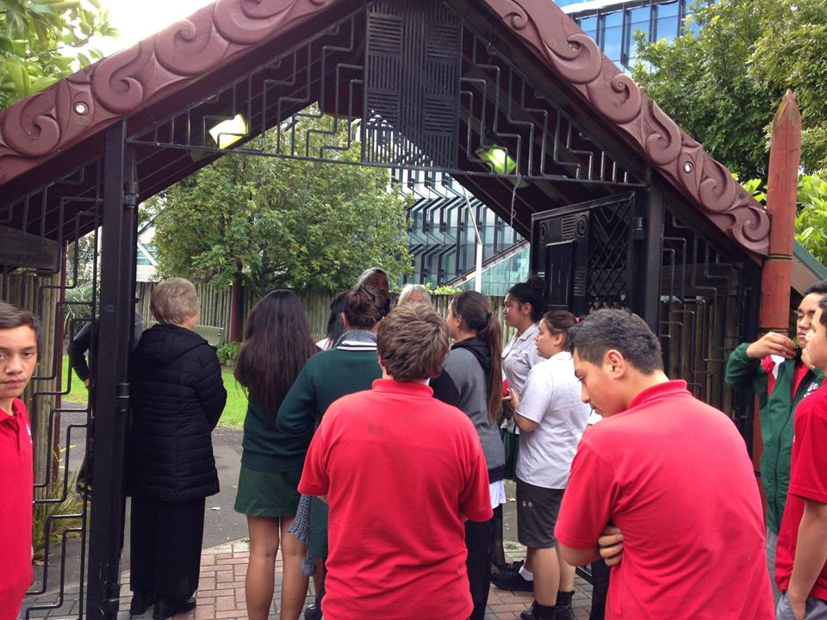
Coming Up
PTE: The team is looking at providing a short course or two to ensure maintenance of the PTE after all compliance work is approved.
Strategic Planning Day: We have planned a strategic planning day for Friday 15 July 2016.

